Slide 1
Integers
Topics
    Numeric Encodings (2.2)
      Unsigned & Two’s complement
      C promotion rules
    Basic operations (2.3)
      Addition, negation, multiplication
      Consequences of overflow
      Using shifts to perform power-of-2 multiply/divide

Slide 2

Unsigned Addition
u
• • •
Operands: w bits
+
v
• • •
True Sum: w+1 bits
u + v
• • •
Discard Carry: w bits
UAdd_{w}(u , v)
• • •
Standard Addition Function
  Ignores carry output
Implements Modular Arithmetic
  s = UAdd_{w}(u , v) = u + v mod 2^{w}

Slide 3
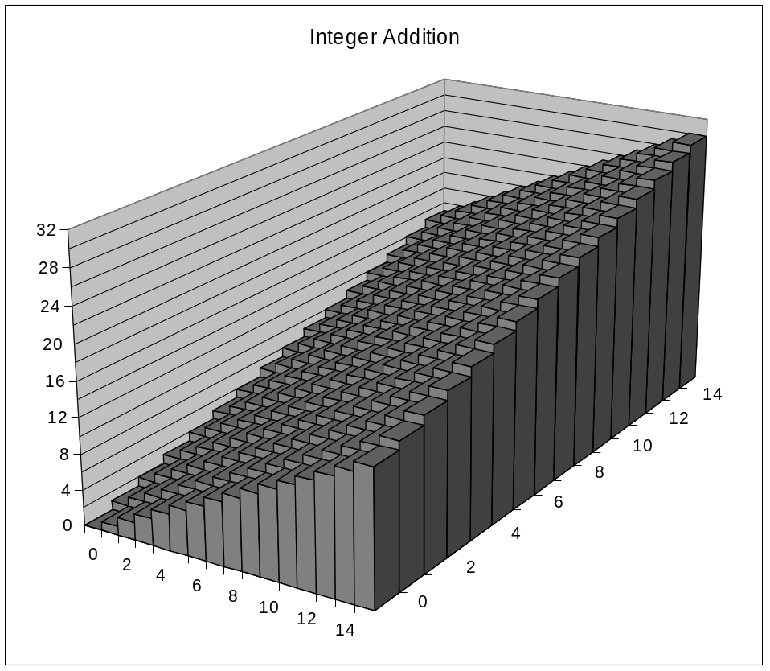
Visualizing Integer Addition
Integer Addition
  4-bit integers u, v
  Compute true sum Add₄(u , v)
  Values increase linearly with u and v
  Forms planar surface
Add₄(u , v)
v
u

Slide 4
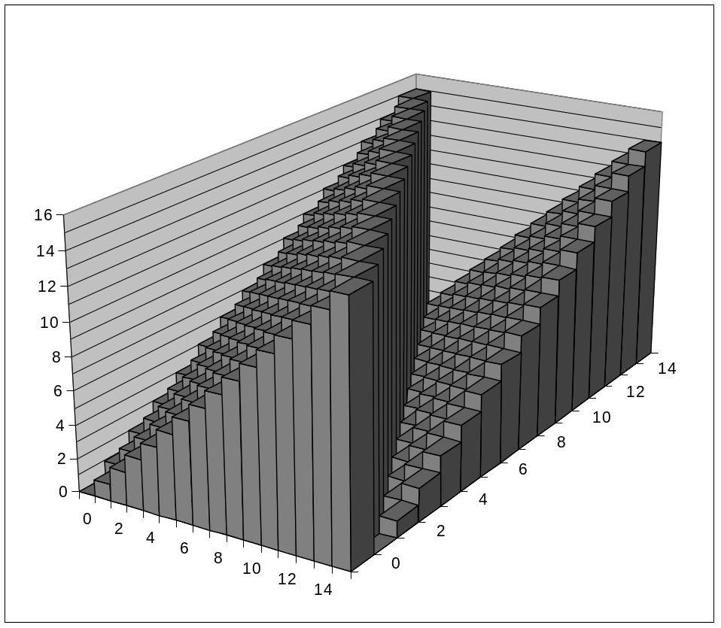
Visualizing Unsigned Addition
Wraps Around
  If true sum ≥ 2^{w}
  At most once
Overflow
UAdd₄(u , v)
True Sum
2^{w+1}
Overflow
2^{w}
v
0
Modular Sum
u

Slide 5
Mathematical Properties
Modular Addition Forms an Abelian Group
  Closed under addition
    0 ≤ UAdd_{w}(u , v) ≤ 2^{w} –1
  Commutative
    UAdd_{w}(u , v) = UAdd_{w}(v , u)
  Associative
    UAdd_{w}(t, UAdd_{w}(u , v)) = UAdd_{w}(UAdd_{w}(t, u ), v)
  0 is additive identity
    UAdd_{w}(u , 0) = u
  Every element has additive inverse
    Let UComp_{w} (u ) = 2^{w} – u
    UAdd_{w}(u , UComp_{w} (u )) = 0

Slide 6
Two’s Complement Addition
u
• • •
Operands: w bits
+
v
• • •
True Sum: w+1 bits
u + v
• • •
Discard Carry: w bits
TAdd_{w}(u , v)
• • •
TAdd and UAdd have Identical Bit-Level Behavior
  Signed vs. unsigned addition in C:
  int s, t, u, v;
  s = (int) ((unsigned) u + (unsigned) v);
  t = u + v
  Will give s == t

Slide 7
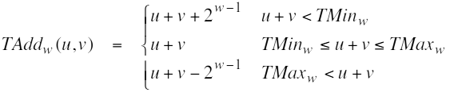
Characterizing Tadd
Functionality
  True sum requires w+1 bits
  Drop off MSB
  Treat remaining bits as 2’s comp. integer
True Sum
0 111…1
2^{w}–1
PosOver
TAdd Result
0 100…0
2^{w –1}
011…1
0 000…0
0
000…0
PosOver
1 100…0
–2^{w –1}
100…0
TAdd(u , v)
1 000…0
–2^{w}
NegOver
> 0
v
< 0
(NegOver)
< 0
> 0
u
(PosOver)
NegOver

Slide 8
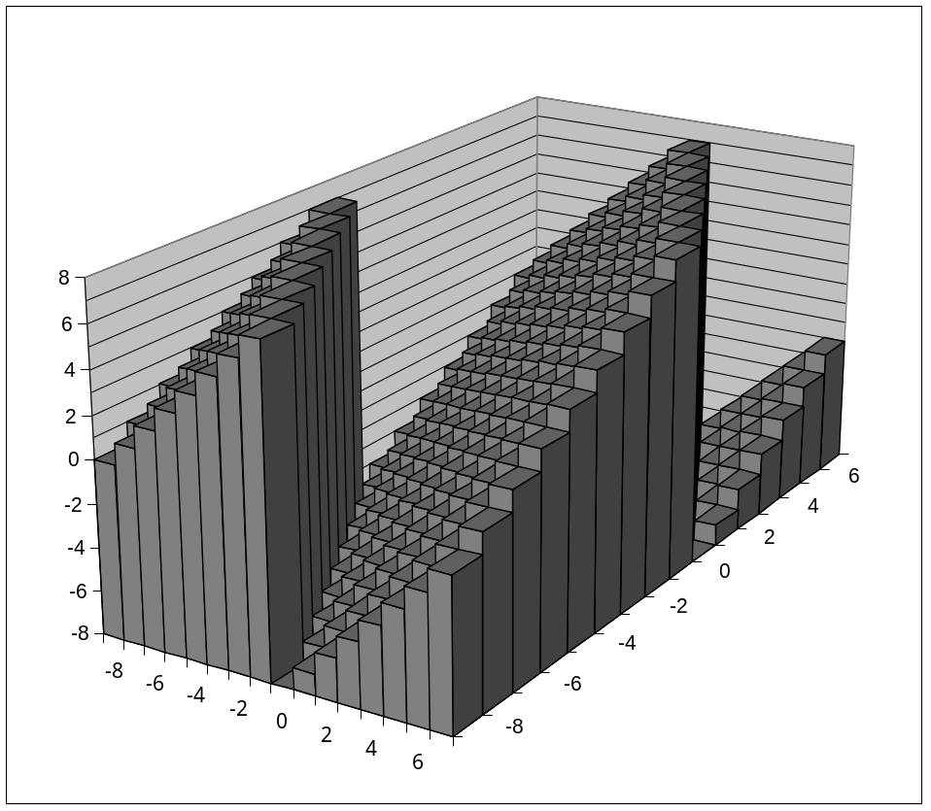
Visualizing 2’s Compl. Addition
Values
  4-bit two’s comp.
  Range from -8 to +7
Wraps Around
  If sum ≥ 2^{w–1}
    Becomes negative
    At most once
  If sum < –2^{w–1}
    Becomes positive
    At most once
NegOver
TAdd₄(u , v)
v
u
PosOver

Slide 9
Detecting 2’s Comp. Overflow
Task
  Given s = TAdd_{w}(u , v)
  Determine if s = Add_{w}(u , v)
  Example
  int s, u, v;
  s = u + v;
Claim
  Overflow iff either:
    u, v < 0, s ≥ 0 (NegOver)
    u, v ≥ 0, s < 0 (PosOver)
  ovf = (u<0 == v<0) && (u<0 != s<0);
2^{w}–1
PosOver
2^{w –1}
0
NegOver

Slide 10
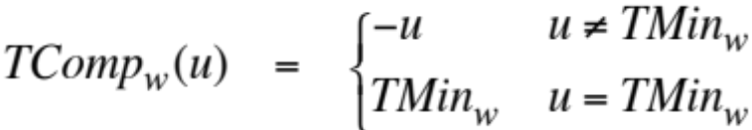
Math Property of Tadd
Isomorphic Algebra to UAdd
  TAdd_{w}(u , v) = U2T(UAdd_{w}(T2U(u ), T2U(v)))
    Since both have identical bit patterns
Two’s Complement Under TAdd Forms a Group
  Closed, Commutative, Associative, 0 is additive identity
  Every element has additive inverse
    Let TComp_{w} (u ) = U2T(UComp_{w}(T2U(u ))
    TAdd_{w}(u , TComp_{w} (u )) = 0

Slide 11
Multiplication
Computing Exact Product of w-bit numbers x, y
  Either signed or unsigned
Ranges
  Unsigned: 0 ≤ x * y ≤ (2^{w} – 1) ² = 2^{2w} – 2^{w+1} + 1
    Up to 2w bits
  Two’s complement min: x * y ≥ (–2^{w–1})*(2^{w–1}–1) = –2^{2w–2} + 2^{w–1}
    Up to 2w–1 bits
  Two’s complement max: x * y ≤ (–2^{w–1}) ² = 2^{2w–2}
    Up to 2w bits, but only for (TMin_{w})²
Maintaining Exact Results
  Would need to keep expanding word size with each product computed
  Done in software by “arbitrary precision” arithmetic packages

Slide 12
Unsigned Mult in C
u
• • •
Operands: w bits
*
v
• • •
True Product: 2*w bits
u · v
• • •
• • •
Discard w bits: w bits
UMult_{w}(u , v)
• • •
Standard Multiplication Function
  Ignores high order w bits
Implements Modular Arithmetic
  UMult_{w}(u , v) = u · v mod 2^{w}

Slide 13
Unsigned vs. Signed Mult
Unsigned Multiplication
  unsigned ux = (unsigned) x;
  unsigned uy = (unsigned) y;
  unsigned up = ux * uy
  Truncates product to w-bit number up = UMult_{w}(ux, uy)
  Modular arithmetic: up = ux ⋅ uy mod 2^{w}
Two’s Complement Multiplication
  int x, y;
  int p = x * y;
  Compute exact product of two w-bit numbers x, y
  Truncate result to w-bit number p = TMult_{w}(x, y)
Relation
  Signed multiplication gives same bit-level result as unsigned
  up == (unsigned) p

Slide 14
Mult with Shift
Operation
  u << k gives u * 2^{k}
  Both signed and unsigned
Examples
  u << 3 == u * 8
  u << 5 - u << 3 == u * 24
  Most machines shift and add much faster than multiply
    Compiler generates this code automatically
k
u
• • •
Operands: w bits
*
2^{k}
0
•••
0
1
0
•••
0
0
True Product: w+k bits
u · 2^{k}
• • •
0
•••
0
0
Discard k bits: w bits
UMult_{w}(u , 2^{k})
•••
0
•••
0
0
TMult_{w}(u , 2^{k})

Slide 15
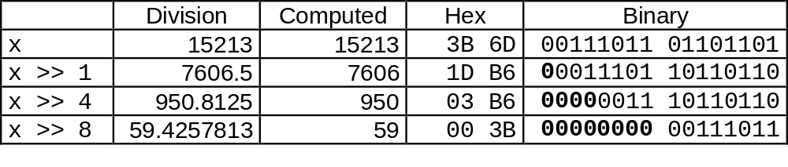
Unsigned Div with Shift
Quotient of Unsigned by Power of 2
  u >> k gives ⎣ u / 2^{k} ⎦
  Uses logical shift
k
u
•••
•••
Binary Point
Operands:
/
2^{k}
0
•••
0
1
0
•••
0
0
Division:
u / 2^{k}
0
•••
•••
.
•••
Result:
⎣ u / 2^{k} ⎦
0
•••
•••

